Slide 1

FIND MY PROTEST
Find My Protest

Slide 2

FMP TEAM
UX: Mana and Weronika
DS: Irem and Paula
DL: Tuğba
WD: Anni and Lydie

Slide 3
Understanding Maya: Meeting Her Information Needs and Proactive Protest Tracking
Maya
Personality
Bio
Social Worker from Berlin-Mitte
Passionate for Environment, Human rights, etc.
Engaged and involved in various movements
PERSONA
Motivation
Needs
Pain Points
Believes in the power of collective action
Stay informed and access reliable info to educate herself and others
Wants to keep track of upcoming protests in her city but frustrated by the lack of centralized resources

Slide 4
Empowering Political Engagement: A Unified Platform for Protests in Berlin.
Problem
Solution
Stay informed, disorganized resources
Unified platform, informed participation
Politically engaged Berliners struggle to stay updated on upcoming protests due to fragmented and disorganized resources. This makes it hard for them to find events aligned with their interests and values.
We propose developing a platform to aggregate historical and future protest data, enabling easy event search based on user interests. Predictive analytics will anticipate public sentiment, empowering users to make informed decisions and actively participate in events aligned with their values.

Slide 5
Empowering Political Engagement: A Unified Platform for Protests in Berlin.
Join us as we unveil a revolutionary platform designed to empower politically engaged citizens in Berlin.
Say goodbye to fragmented resources and hello to a centralized hub for accessing protest information tailored to your interests and values.
From historical data to future events, our platform has you covered. Plus, with predictive analytics, you'll gain valuable insights into public sentiment and reactions.
Get ready to make a difference and stay ahead of the game!

Slide 6

Website-Demo

Slide 7
Website-Demo
For that we developed Find My Protest, a platform for berlin residents to easily find past and future protests events based on their interest.
In Maya’s case, since she is interested in the Environment and lives in Mitte, she can search for upcoming protest on that topic and see if and how any events are available in her area.
By scrolling down to the results and inspecting an event card she can then read more information about the protest such as the event’s theme or subcategory and the number of past or expected participants.
Maya can also search for other specific term outside of the set selectors, such as social justice themes and see if any event can be found. She can then scroll down and click to add more results at the bottom.
If Maya wants to save an event she is interested in for later, she can set up an account and once logged in she would be able to save those events for future viewing.
A Contact and About page is also available on our page if Maya wants to contact or know more about our platform.

Slide 8
Website-Demo
React on Frontend for shaping cards dynamic
2 Backend API routes provided to Frontend: - 1 for search bar - 1 for static query selectors
Data inserted in MongoDB database using a Mongoose Model Schema
Schema modeled from DS set including predicted protests theme and crowd side representation

Slide 9
DATA
PAST DATA: https://acleddata.com/early-warning/
(Collected from Newspapers 16.02.2021-16.02.2024)
FUTURE DATA: https://github.com/demodiff/berlin/tree/main/data%2Fjsonl
(Collected from Versammlungsbehörde 16.02.2024-16.03.2024)
MODIFIED TO 8 COLUMNS: event_date(year, month, day, weekday),district, source(Newspapers), category, subcategory(Theme), title, description(Info), crowd_size_class

Slide 10
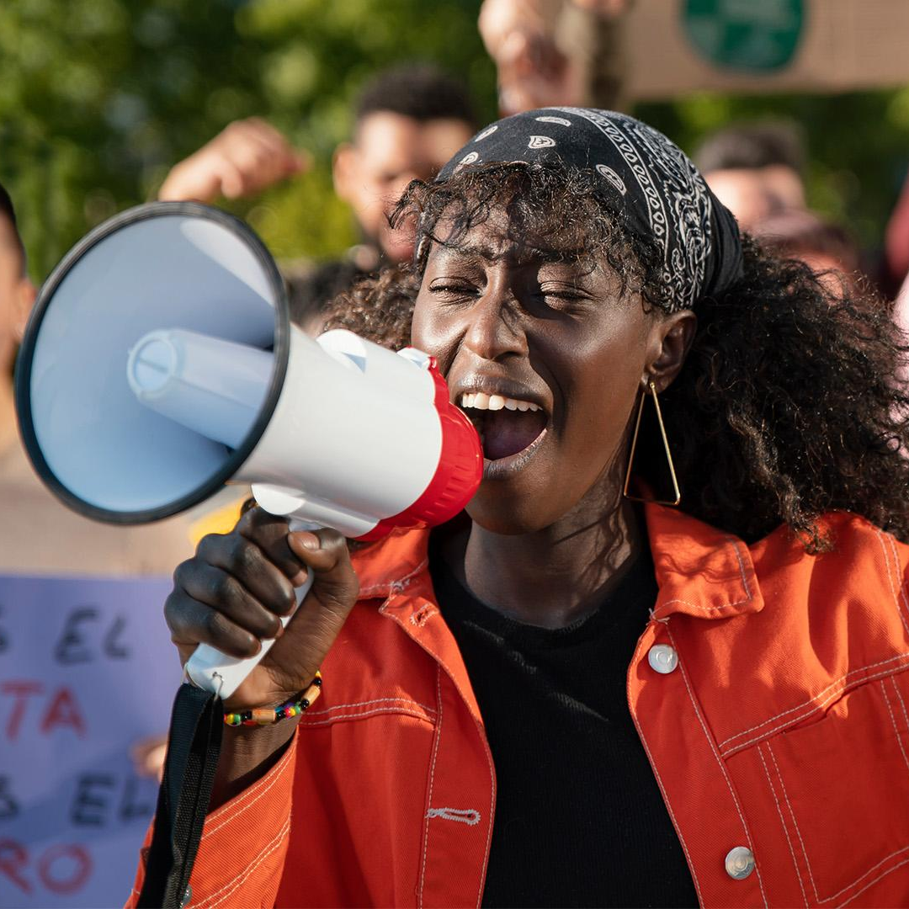
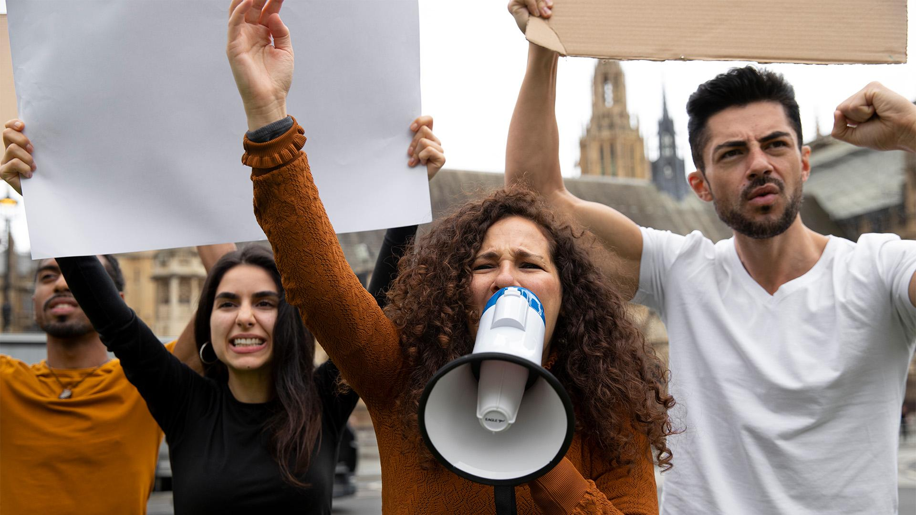
Solved Challenges in DS
Decision
Collecting multiple JSONL files putting them into 1
Research of Translating Data into English
Deciding for Data
Deciding for columns to keep
Cleaning
Shared Google Folder: using Google Sheets and accesing sheets by Google Colab
Taking the Mean, fill NaN, applying Filters, replacing, splitting a column, ….
Classifying Crowd_Size, and Categories(+Subcat)
converting date -> datetime64, numbers -> to_numeric(floar or int)
Analysation
Using Matplotlib, Seaborn & others on the Dataframe
plotting: box, violin, scatter
adjusting diagram & label, finding colours
Prediction
Encoding(OneHotEncoding, manually Indexing)
Researching Forms of Encoding(datetime, label, …)
trying different Models for Predictions:
Knn, Linear Regression,SVC, Decision Tree
-> Adding Regression, Alpha and playing with Neighbors
Comparing Results + Validation
trying on Examples and succeding with it

Slide 11
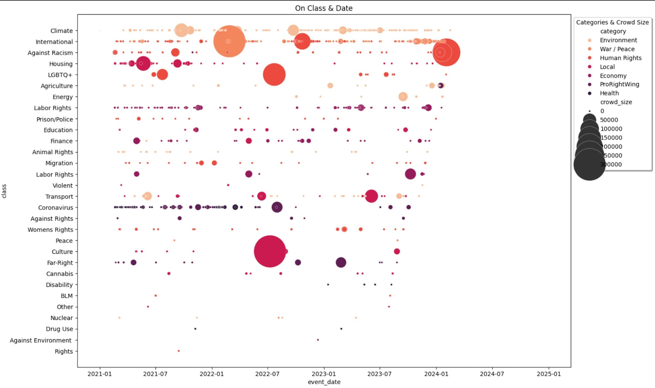
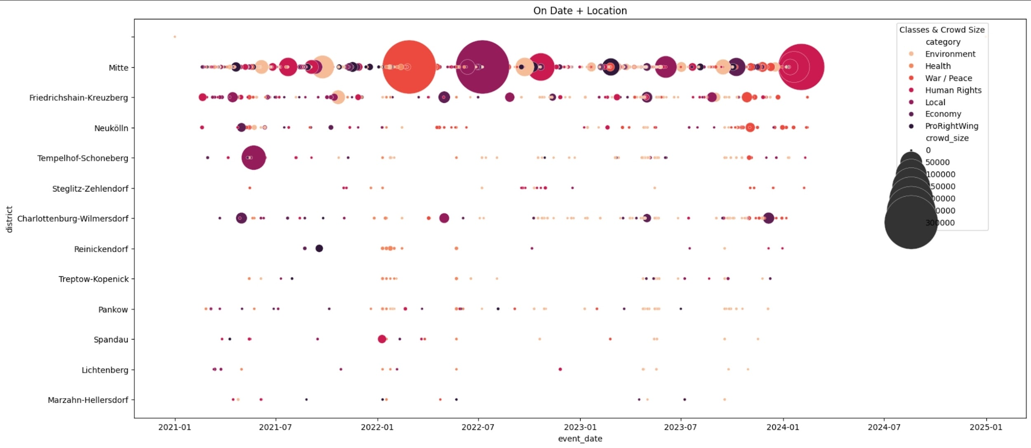
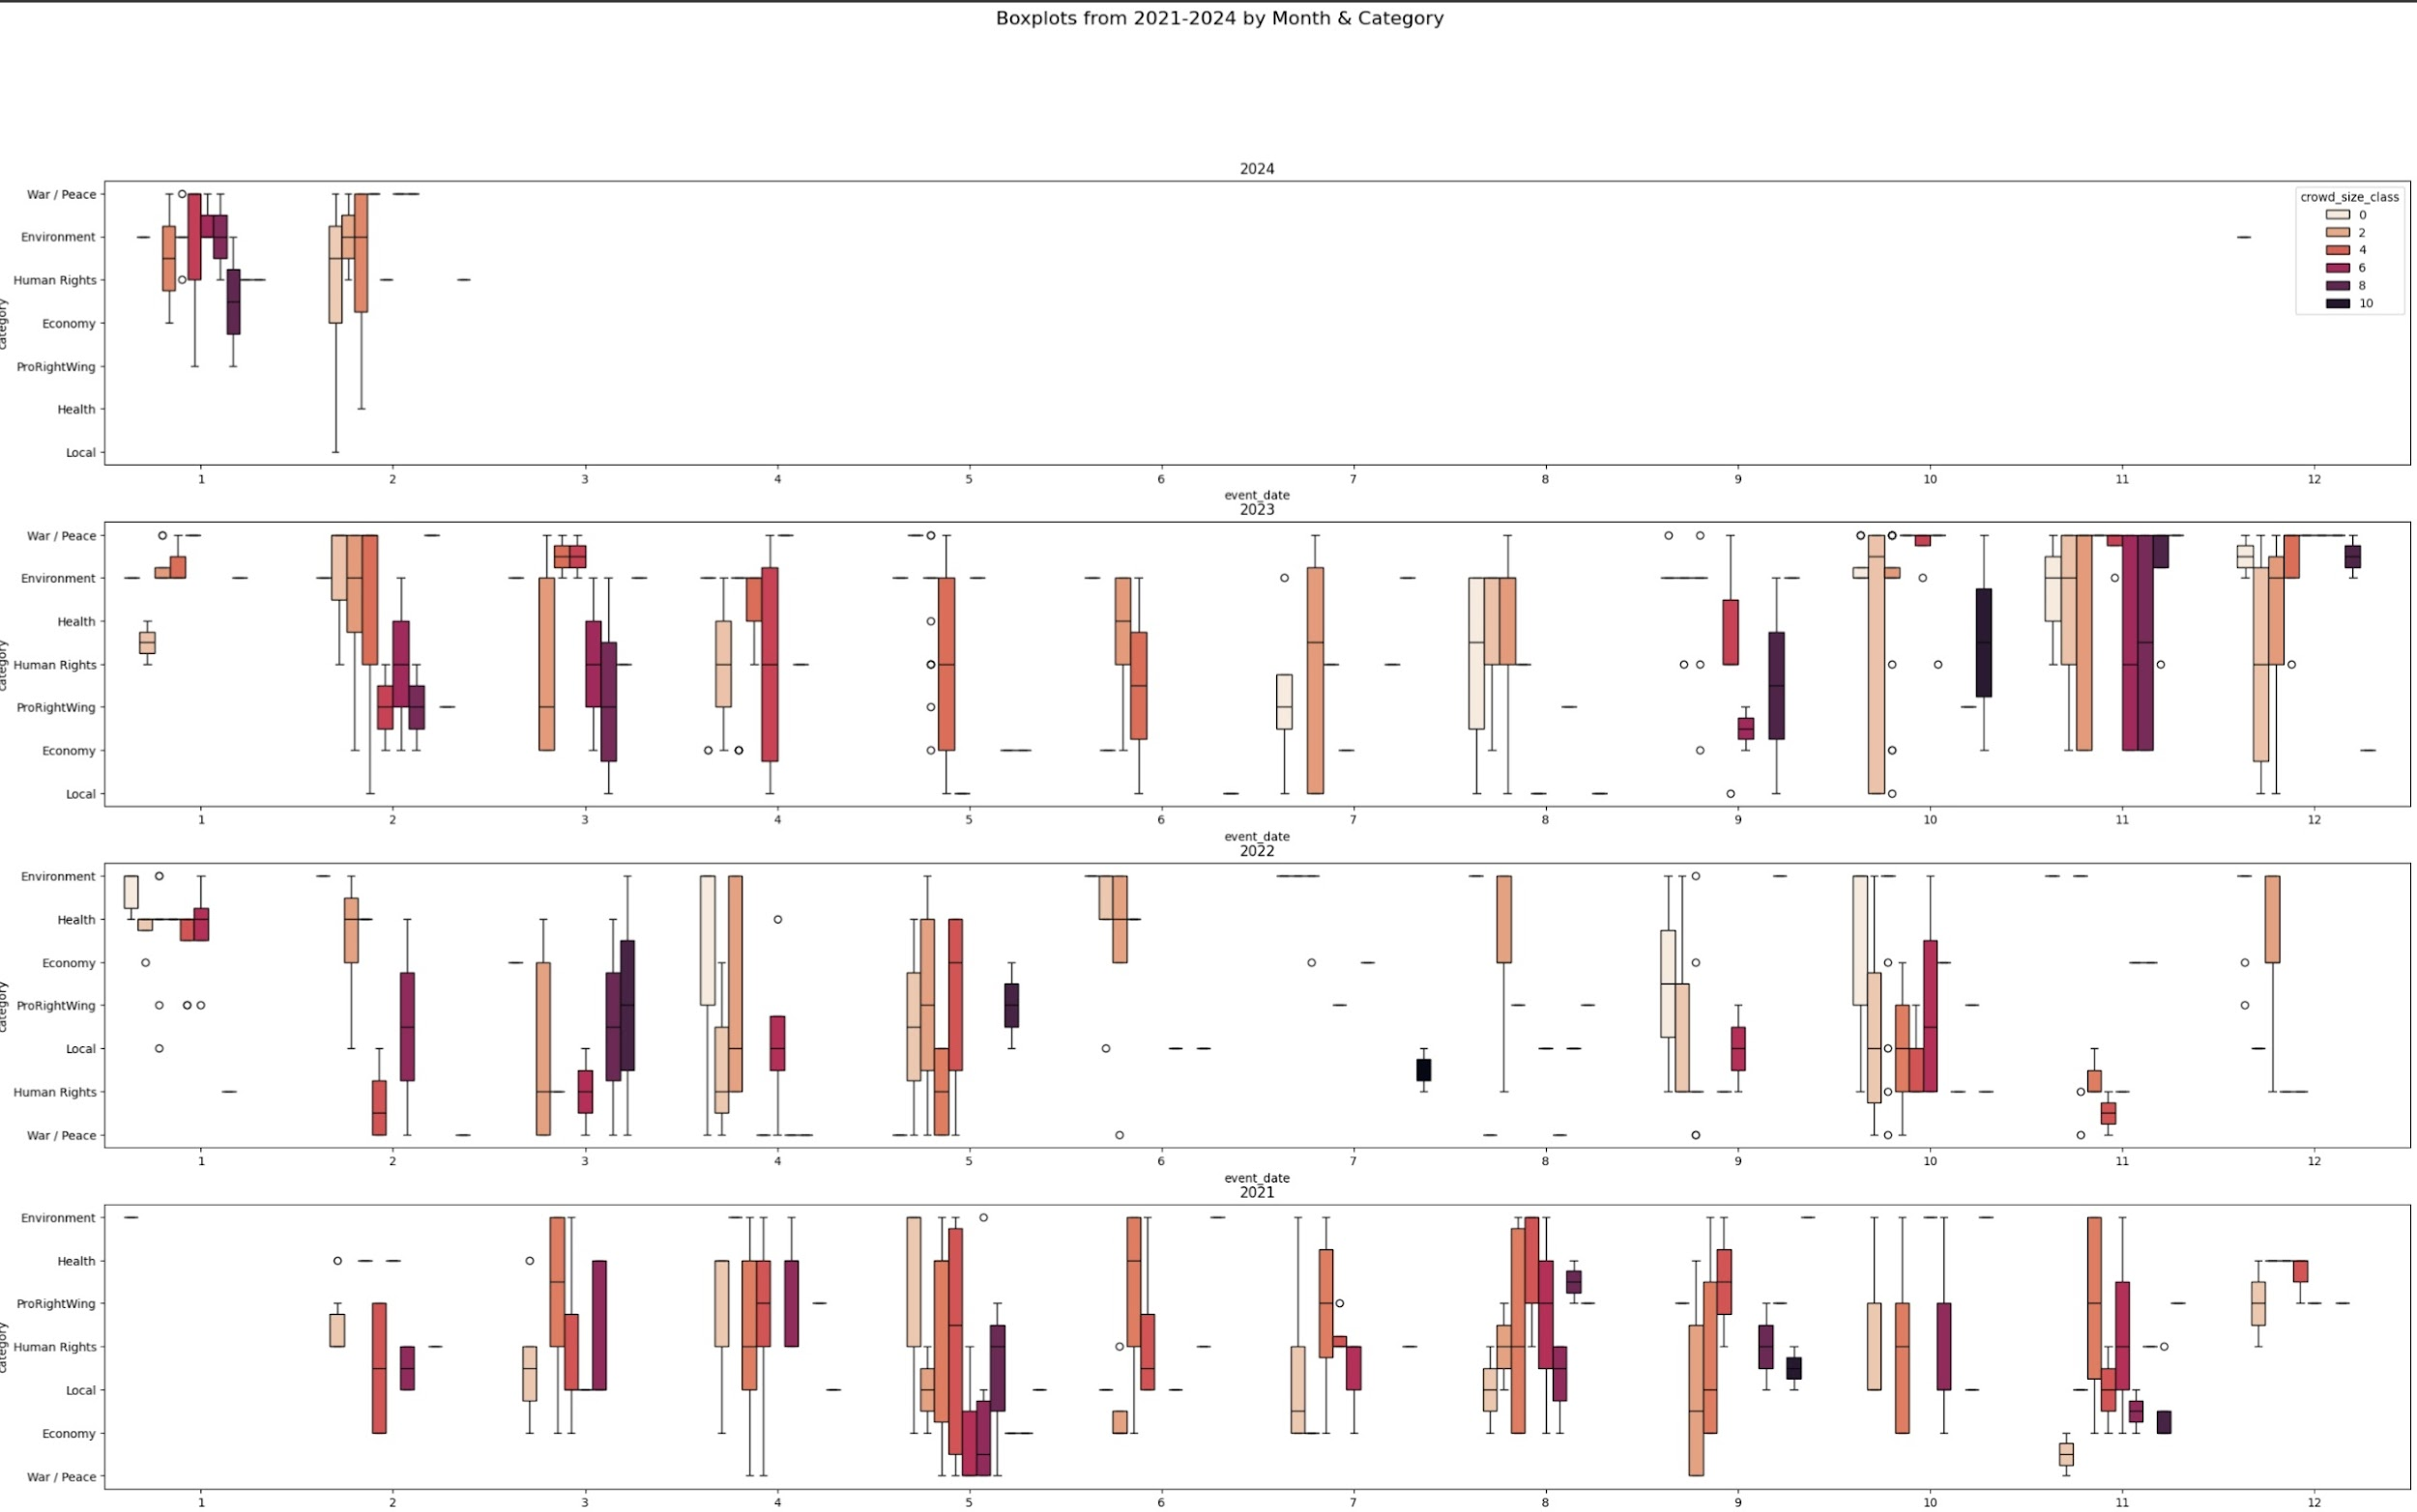
Analysation

Slide 12
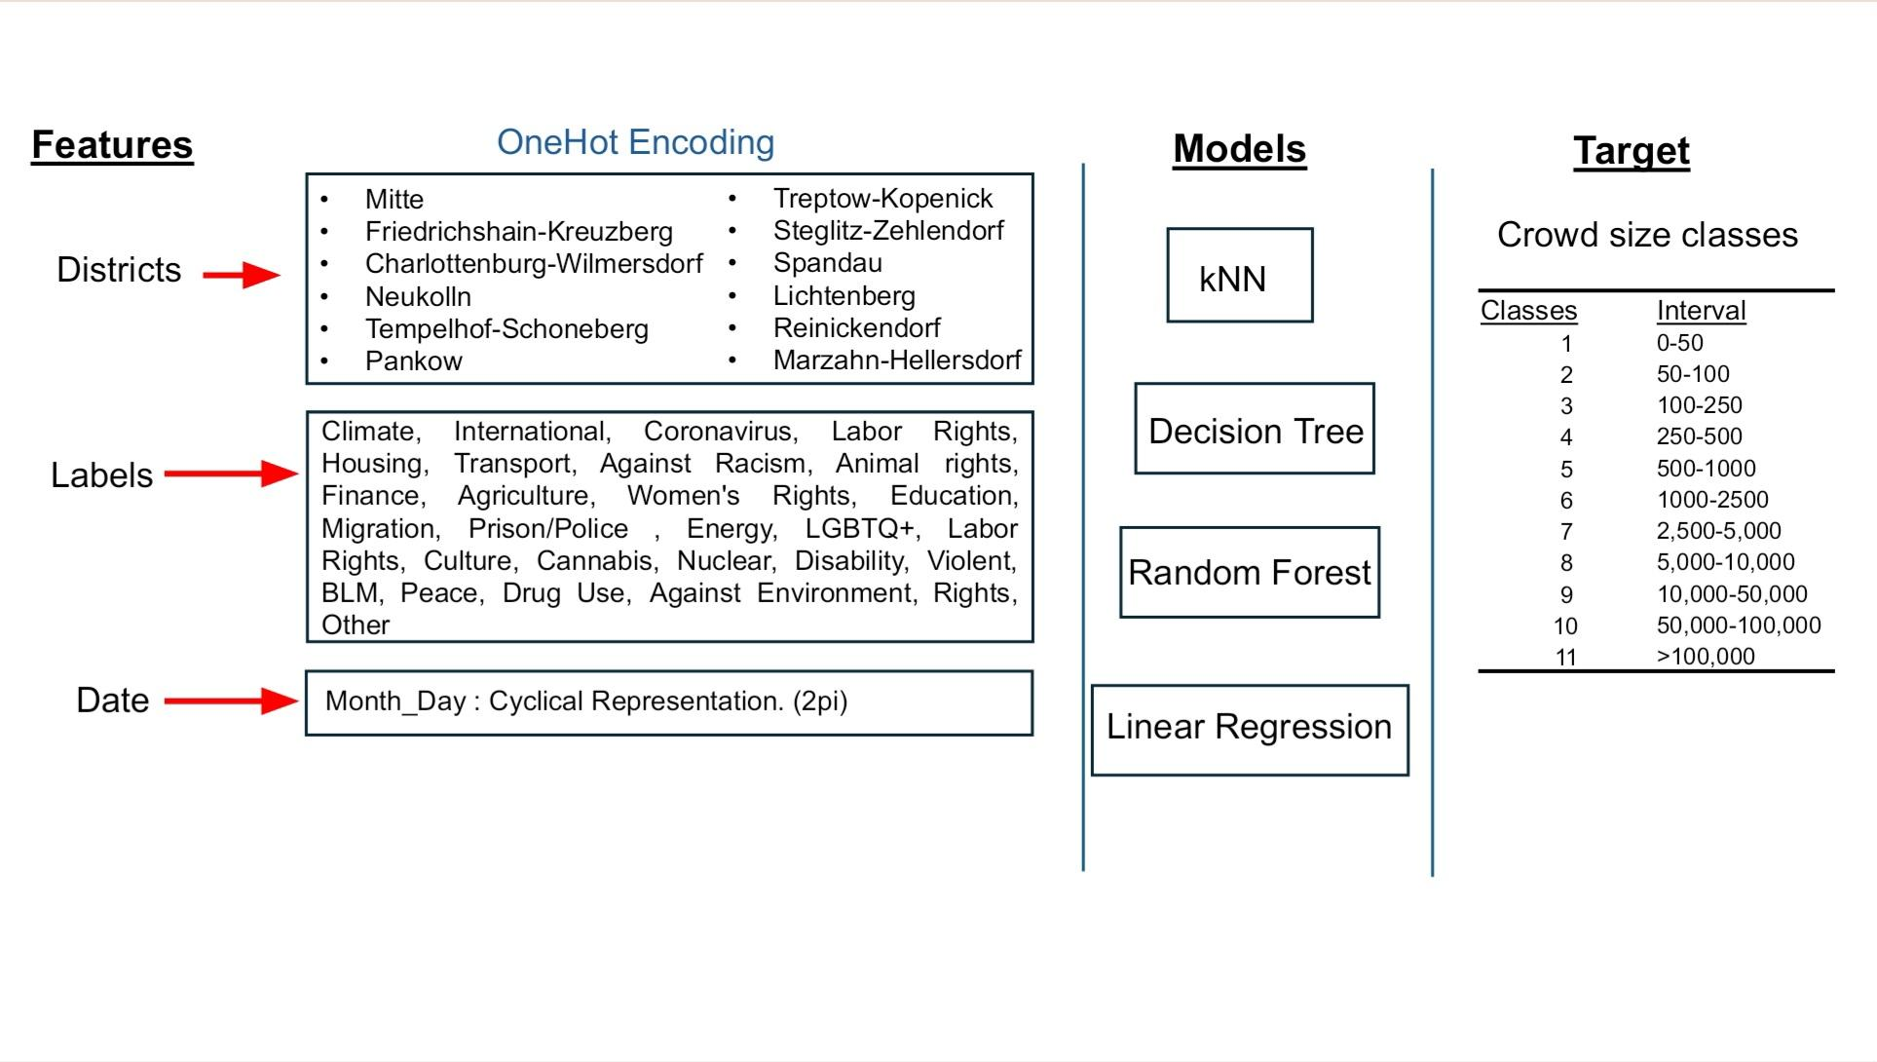
DS PATHWAY

Slide 13

0.40-0.60
train0.94, test 0.36
WE ARE MANY !!!
usual Accuracy in training and test set
Accuracy in KNN(n_neigbor=1)(test_size=0.3)
Prediction Results = very True!!!

Slide 14
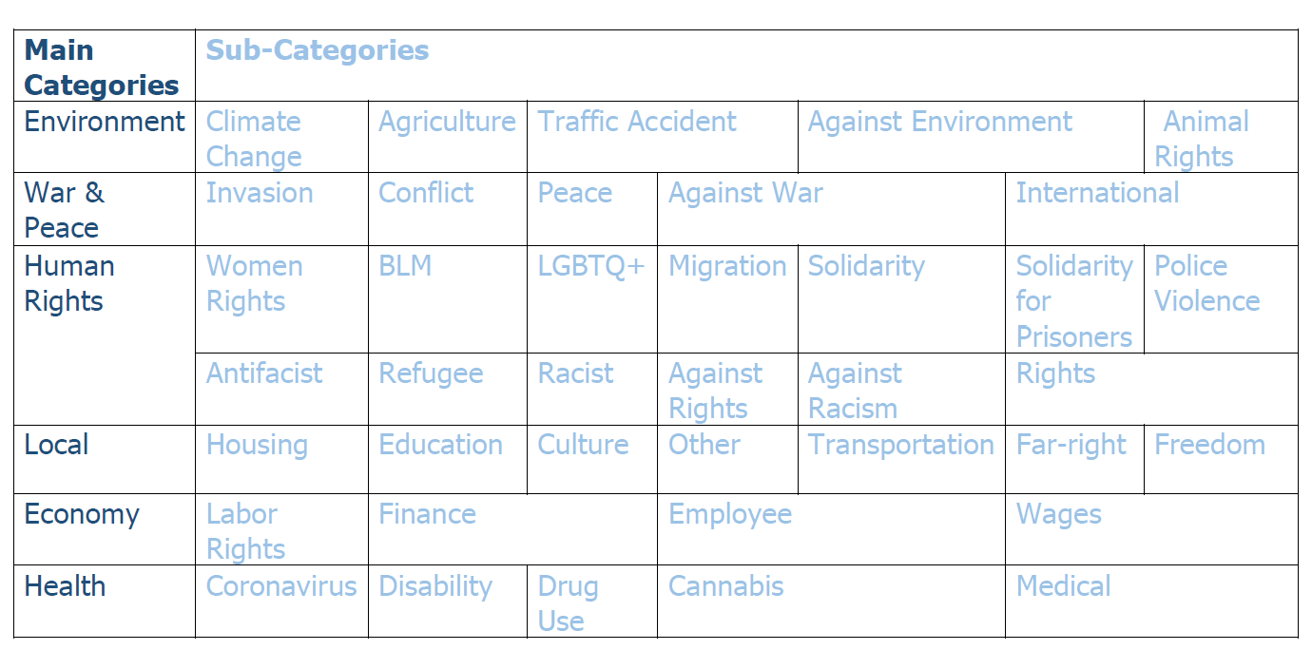
Natural Language Processing (NLP) with DL
Model
Utilized ZERO-SHOT-CLASSIFICATION Algorithm with the "facebook/bart-large-mnli" Model.
Zero-shot classification allows the model to classify protest descriptions without explicit training on protest-related data.
Categories

Slide 15
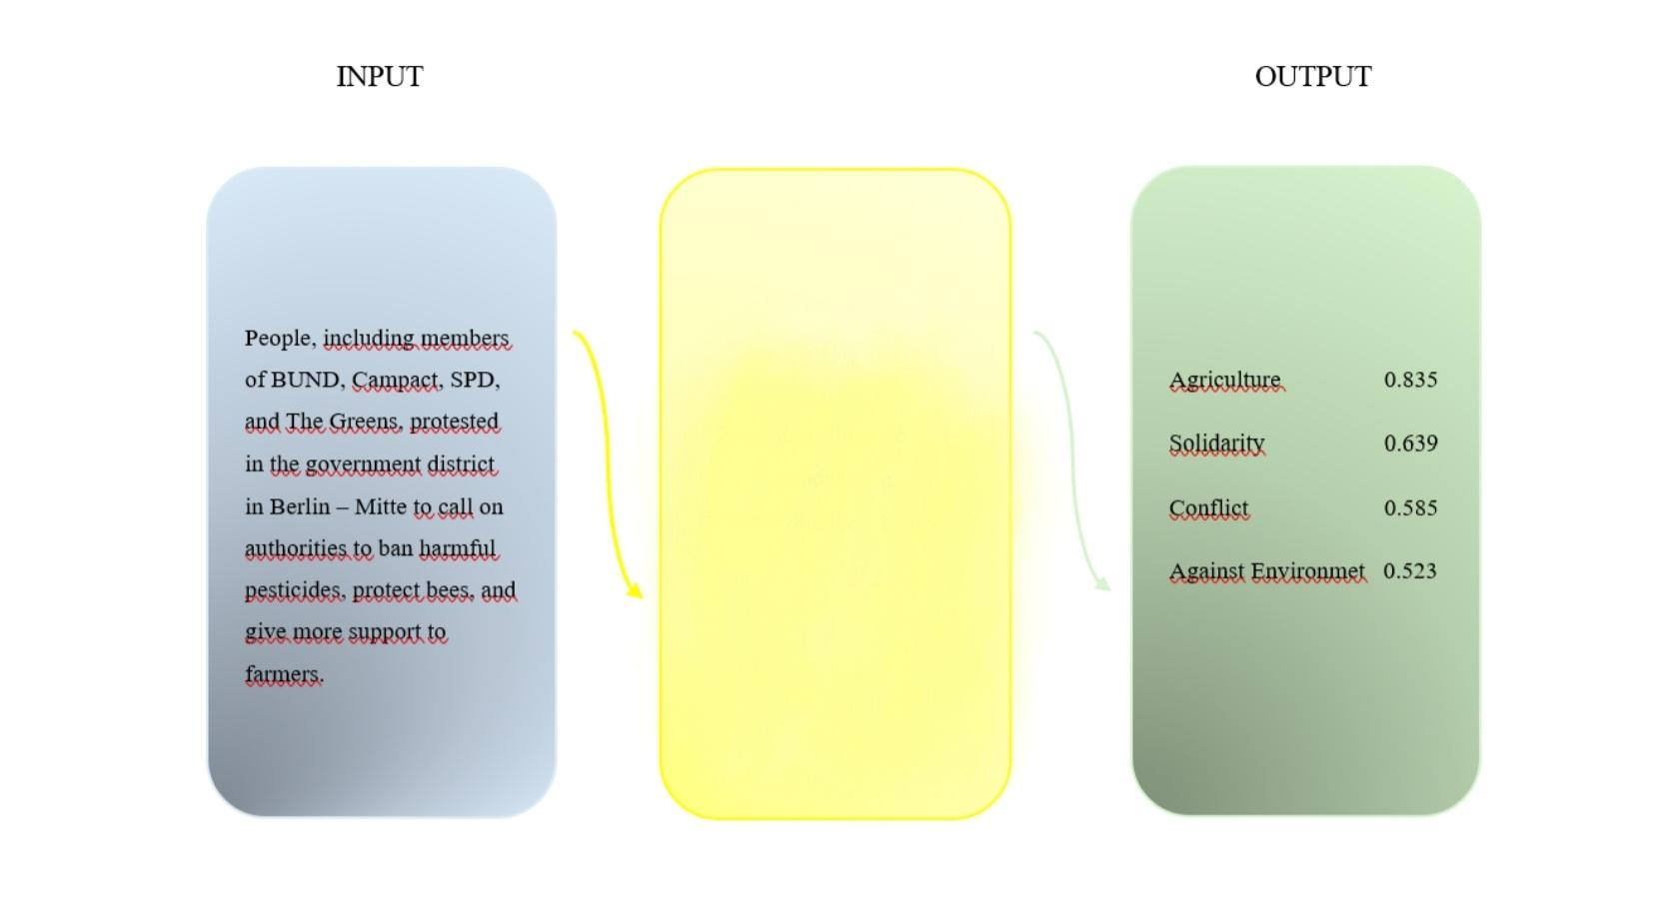
DL PATHWAY
0.835
Prediction Score among target labels
Predicted Theme:
Agriculture
ZERO-SHOT-CLASSIFICATION MODEL WITH “FACEBOOK/BART-LARGE-MNLI”

Slide 16
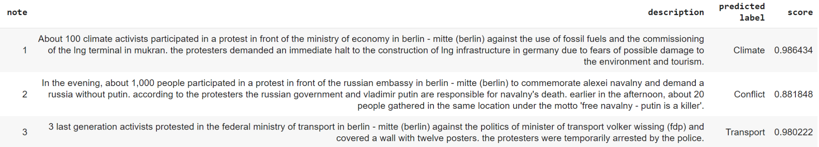
DL PATHWAY
RESULT
According to prediction results climate change and solidarity protests have significantly increased.

Slide 17
Difficulties and Lessons learned
Challenges
Winnings
Finding the right data, understanding what roles the other tracks play and working with Git
Applying all learned theories to a real life project
Gaining Fullstack knowledge on how to build an application from scratch
Becoming a good team and realising our goals

Slide 18
Tech-Stack
UX
WD
Miro, Figma
FE: React, Bootstrap, CSS, JavaScript, HML
BE: Node.js, Express, MongoDB, Mongoose, Joi
DS
DL
Google Colab(Jupyter)
Python(Numpy, Pandas, Matplotlib, Seaborn,
SciKitLearn(Knn, LinReg, DecTree) )
Google Colab
JupyterHub
Python(Numpy, Pandas, Transformers, Sklearn.metrics)

Slide 19
Plans for future development:
Login
Deploy
Refining
Making the app viable by completing the login environment
Store Database in Cloud, deploy Frontend and Backend
Model refinement to increase protest classification precision and granularity.
Share
Implement
Make the app easily accessible online to all project team members!
Implement predictions from Crowd_Size into Database

Slide 20
A special thanks to our amazing mentors!
TaTiANA, ZUBIN,
Rafael & Aljoscha!
We wouldn’t have maKe it without you!

